Slide 1

ISAM 3314 GROUP PROJECT
Group one: Linum

Slide 2
Job Description | Group Members
Register Page | Drew Trey
Search Page | Armando Rosemary
Public Profile Page User Profile Page | Jeff Juan Virginia
Schedule | Meeting Times
November 12, 2018 | 5:00 PM – 7:00 PM
November 14, 2018 | 5:00 PM– 7:00 PM
November 17, 2018 | 10:00 AM – 2:00 PM
November 19, 2018 | 5:00 PM – 7:00 PM
November 21, 2018 | 5:00 PM– 7:00 PM
November 24, 2018 | 10:00 AM – 2:00 PM

Slide 3
User Registration Class Diagram

Slide 4
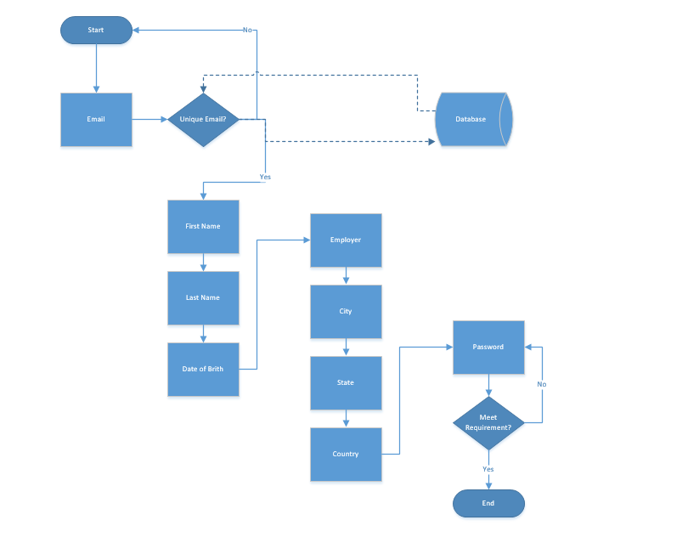
Registration
Flow chart

Slide 5
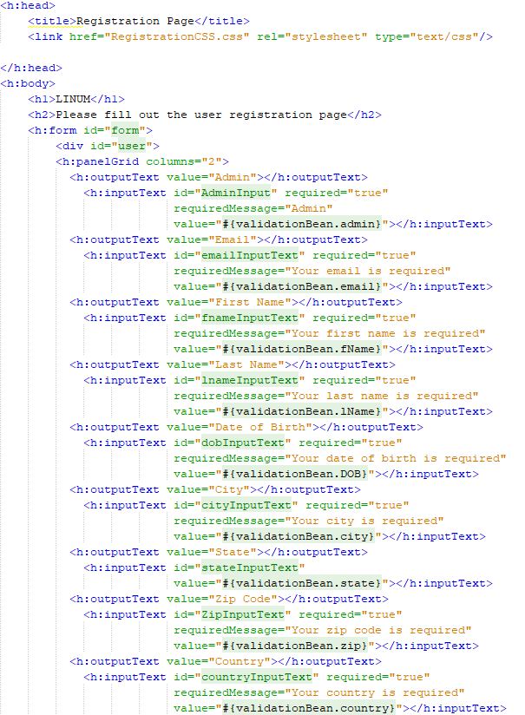

Slide 6
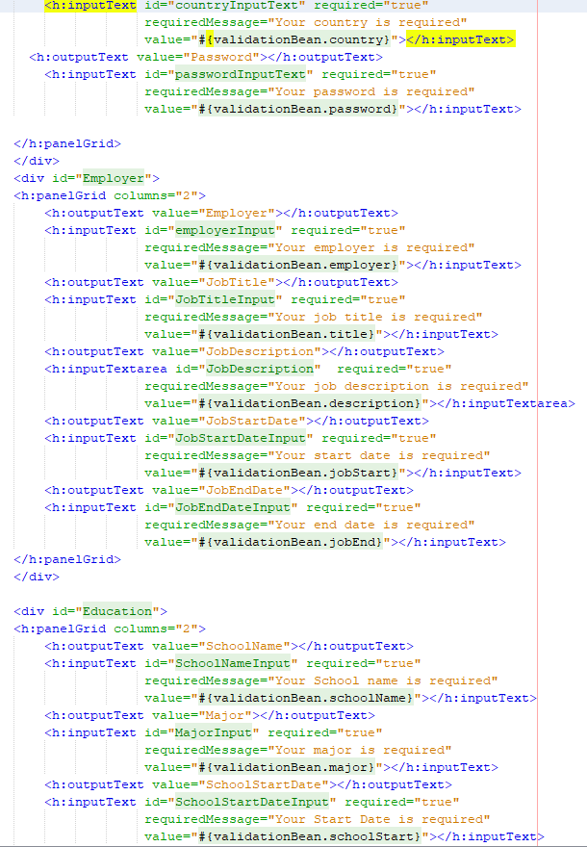

Slide 7
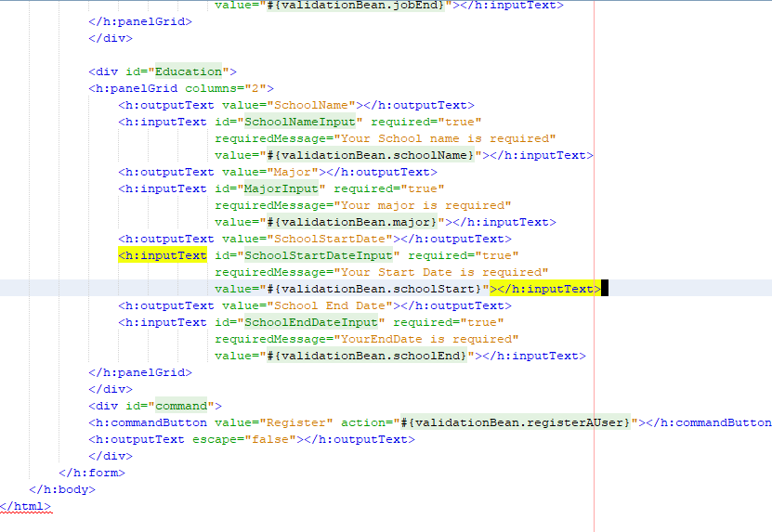

Slide 8
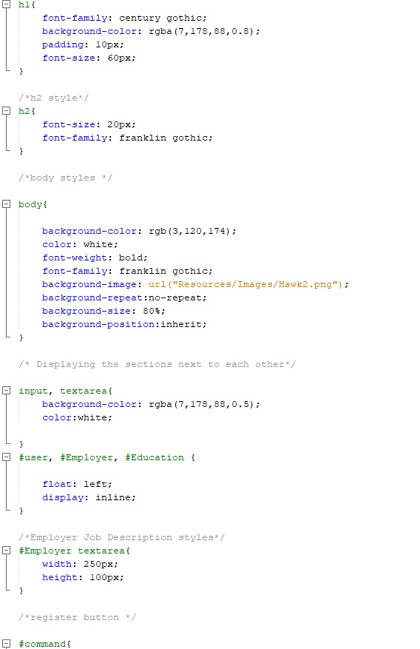
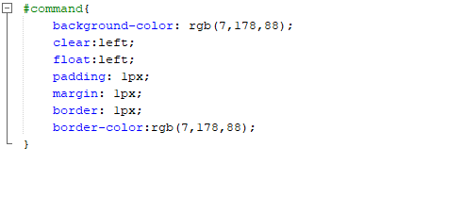
Registration
CSS

Slide 9
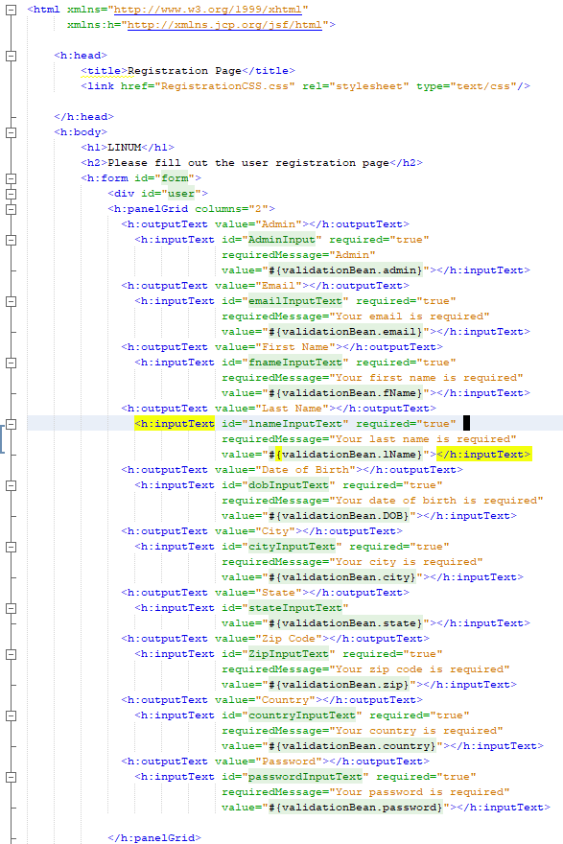
JSF Registration page

Slide 10
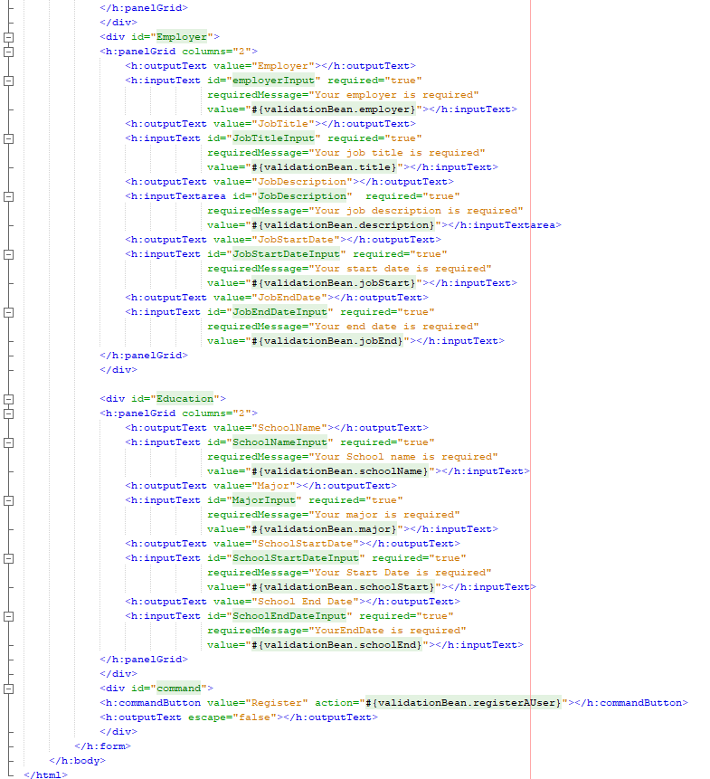

Slide 11
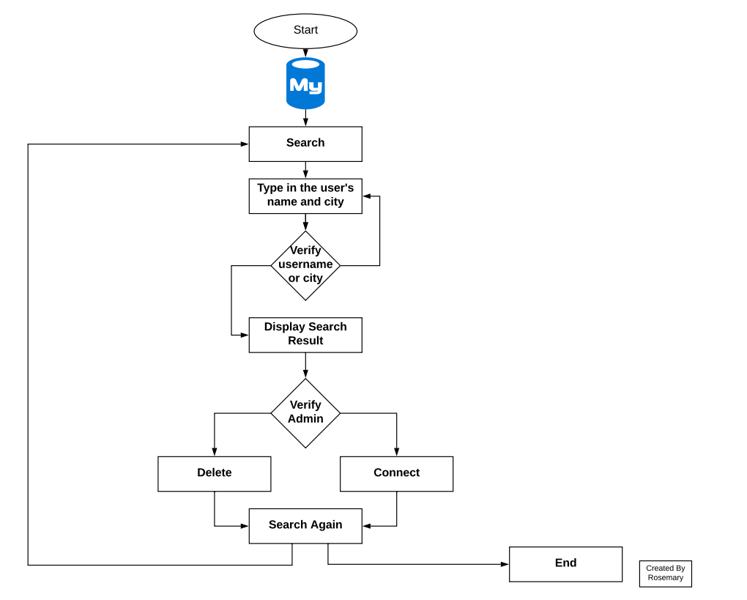
Search Page Flow Chart

Slide 12
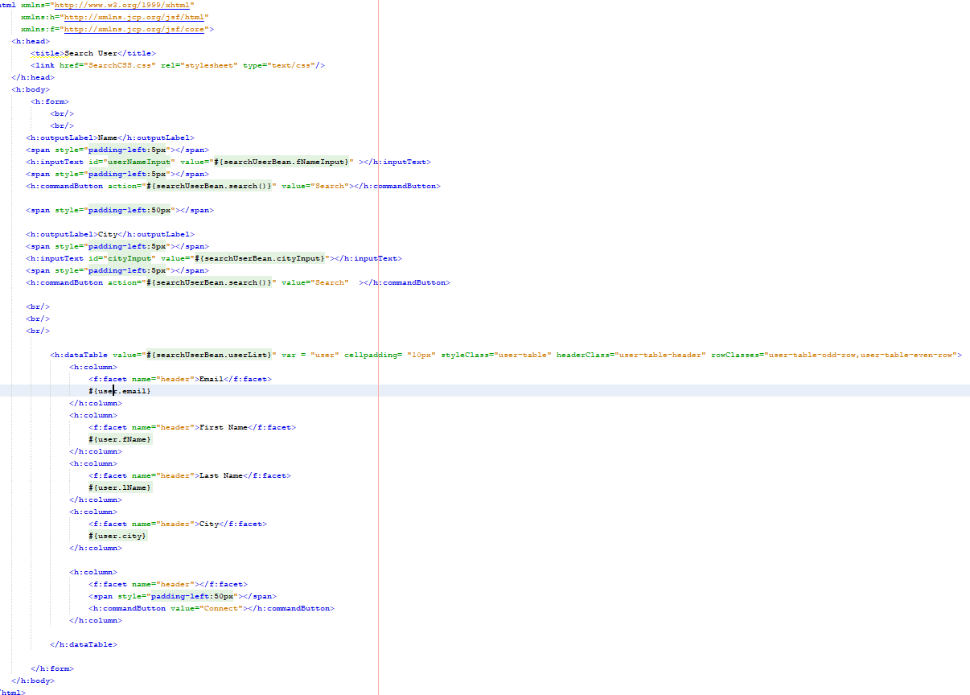
Search page

Slide 13
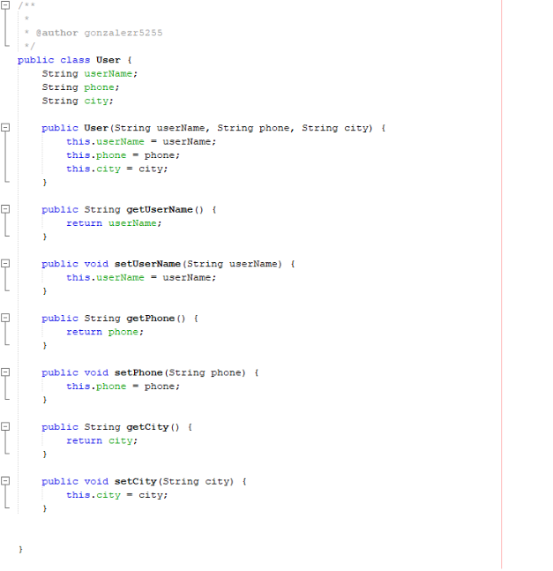

Slide 14
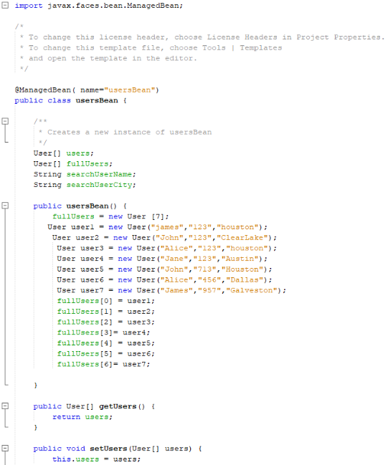

Slide 15
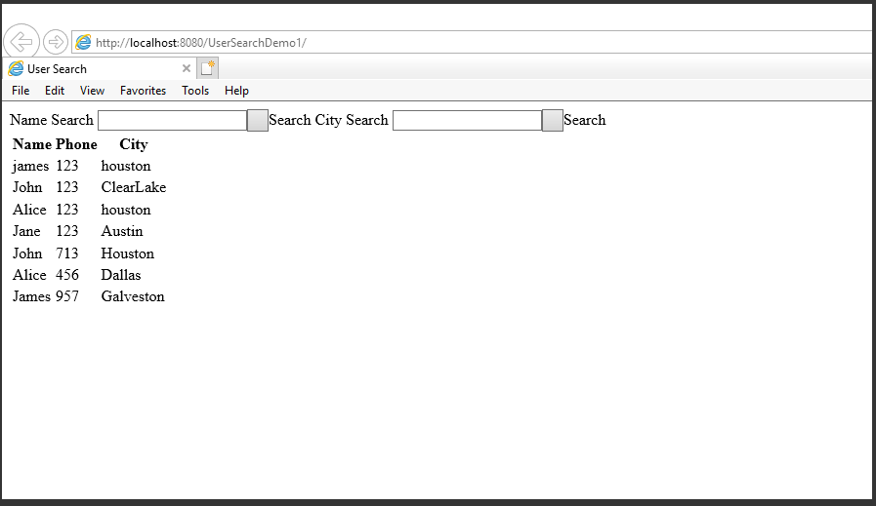

Slide 16
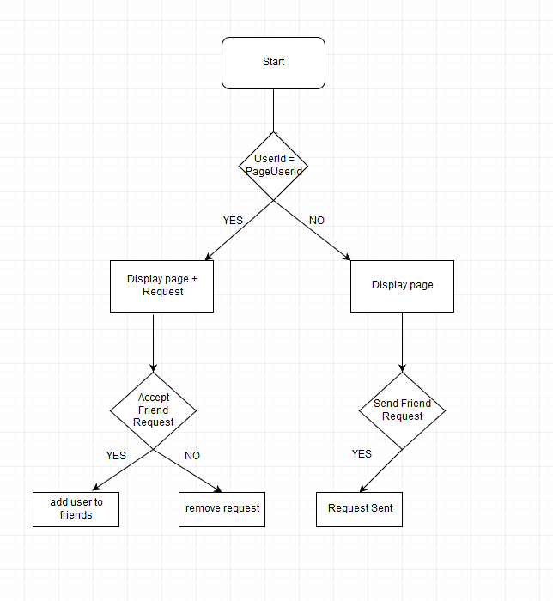
User Pages Flow Chart

Slide 17
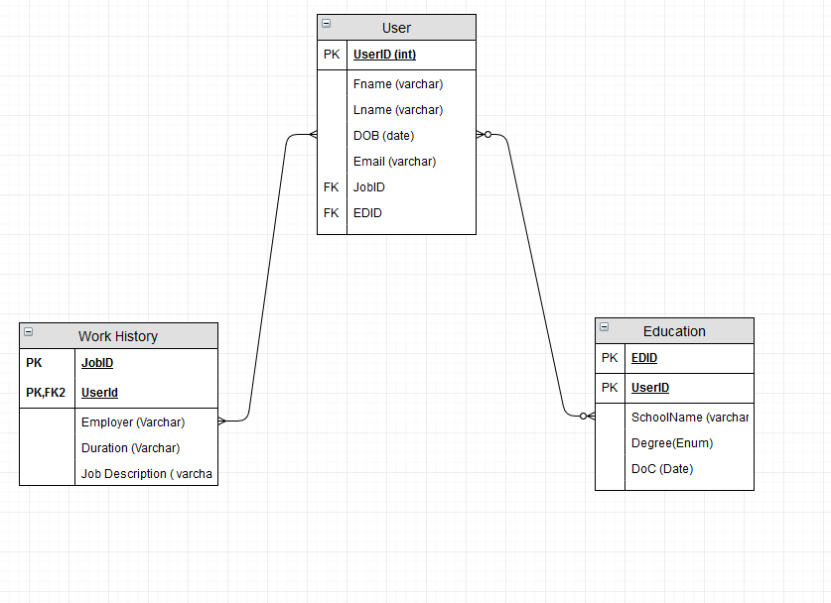
User Pages ERD

Slide 18
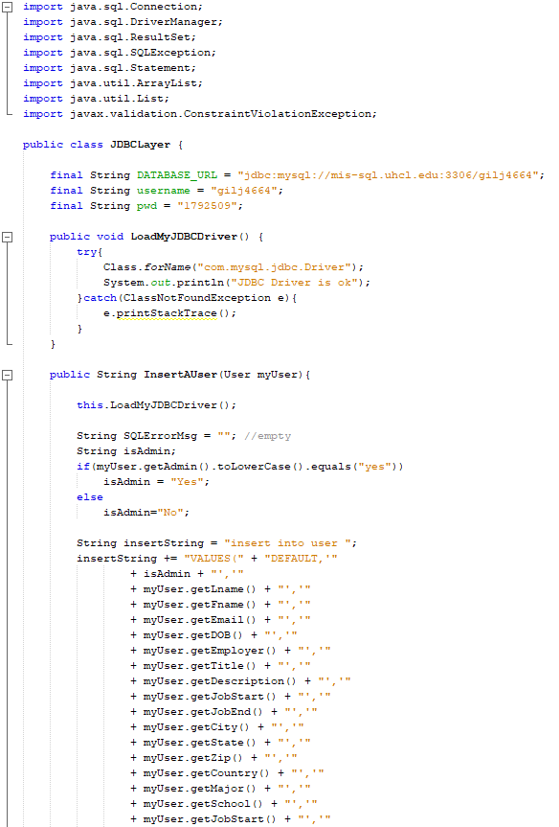
JDBC Layer

Slide 19
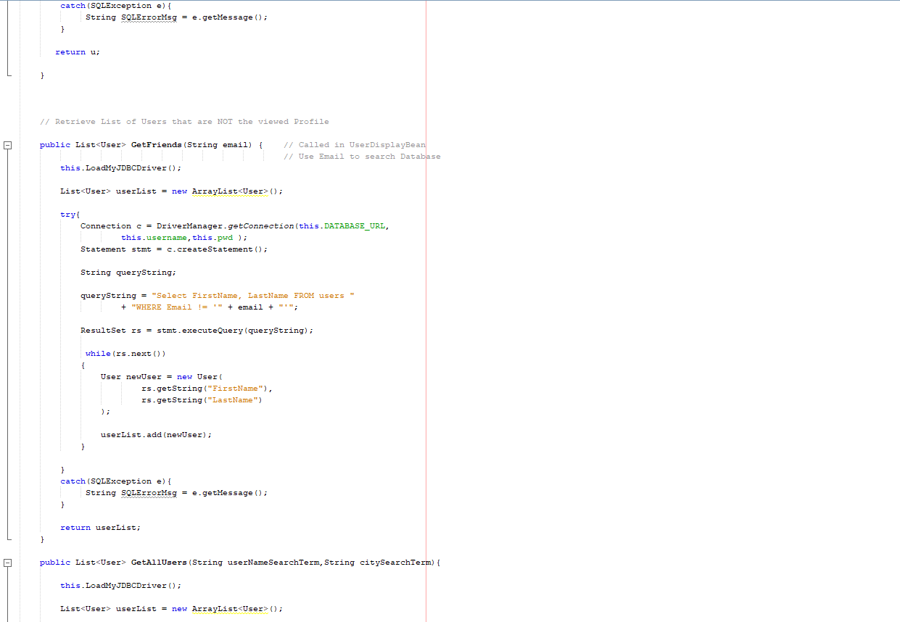

Slide 20
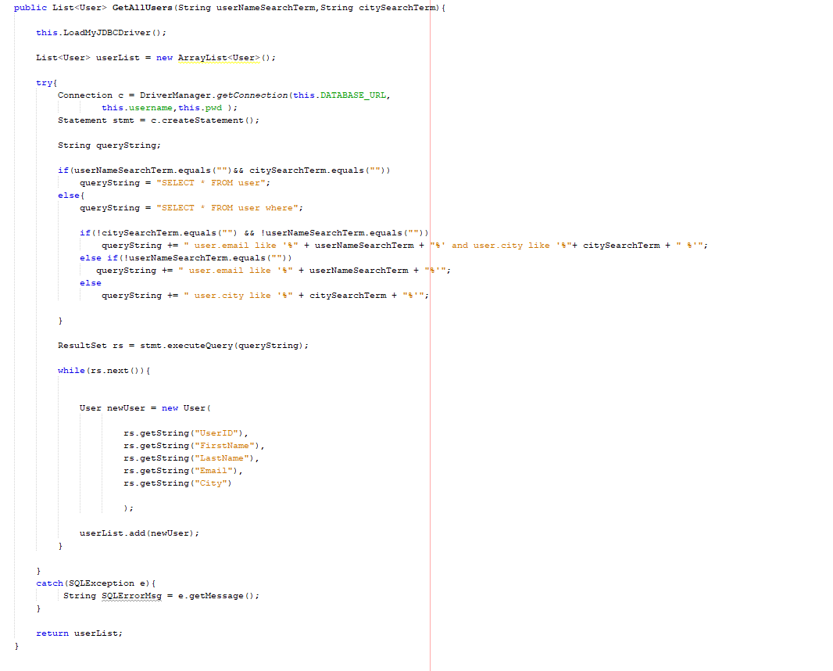

Slide 21
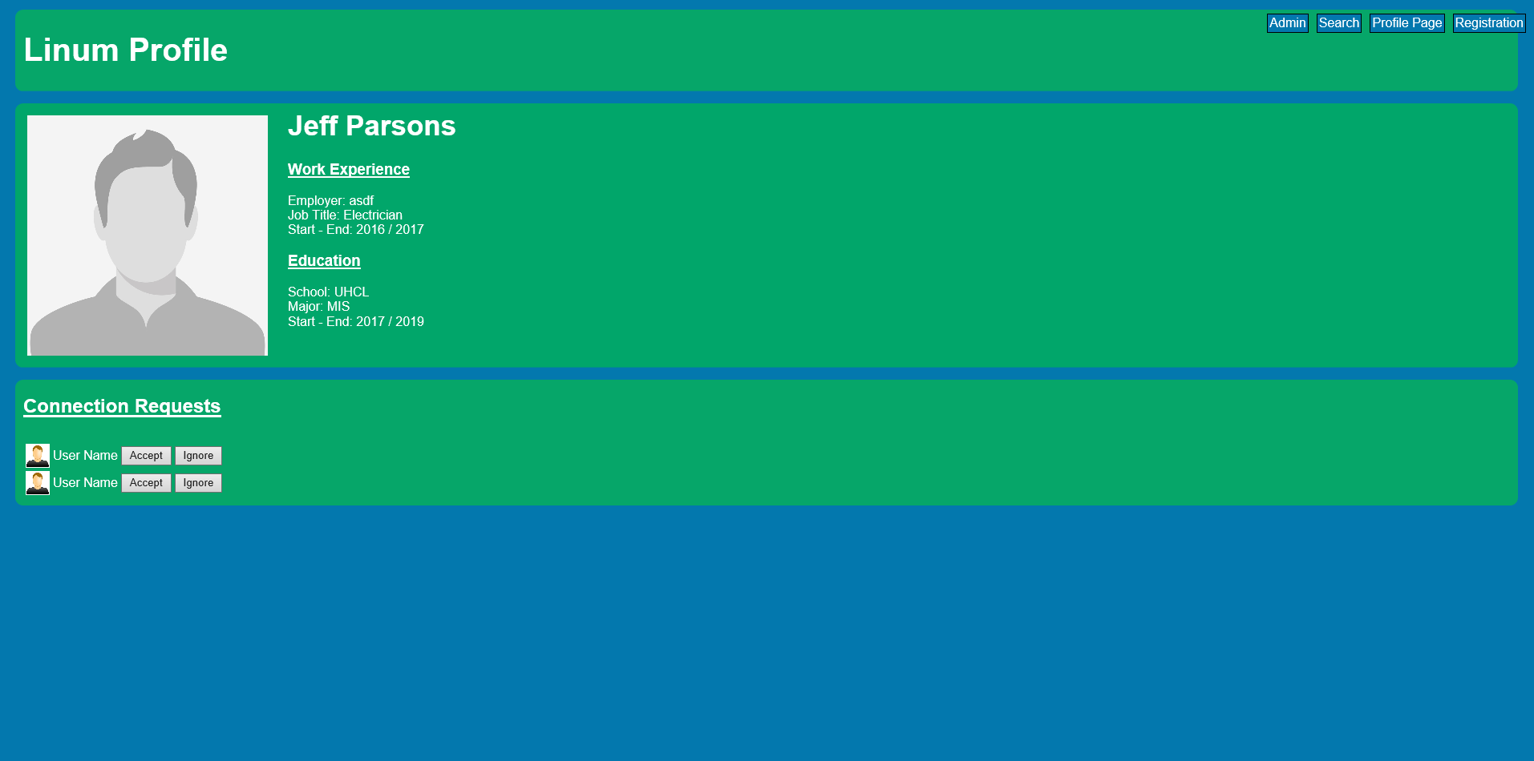

Slide 22
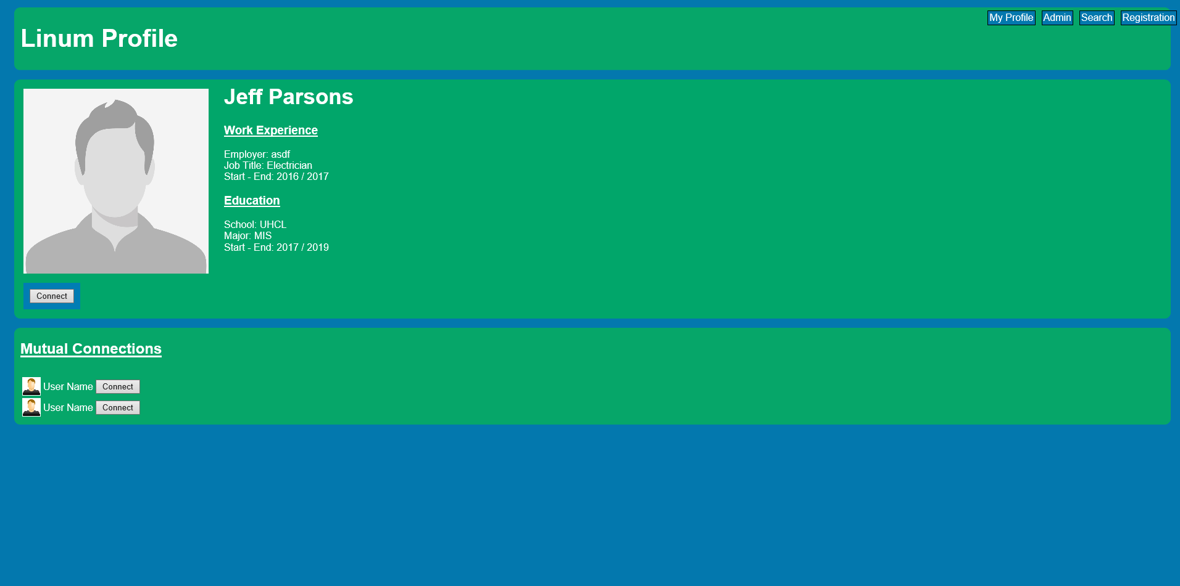

Slide 23
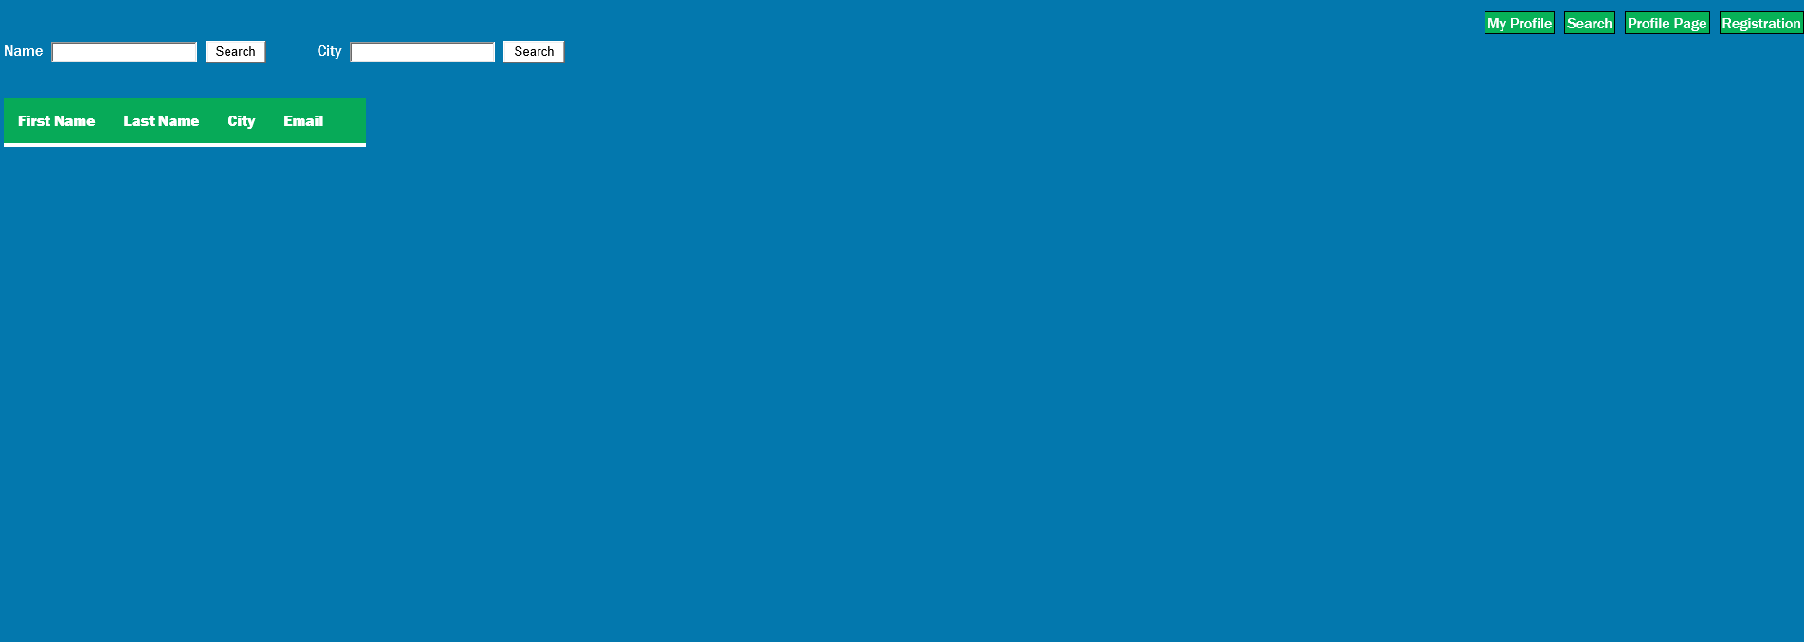
User Search Page

Slide 24
